Slide 1
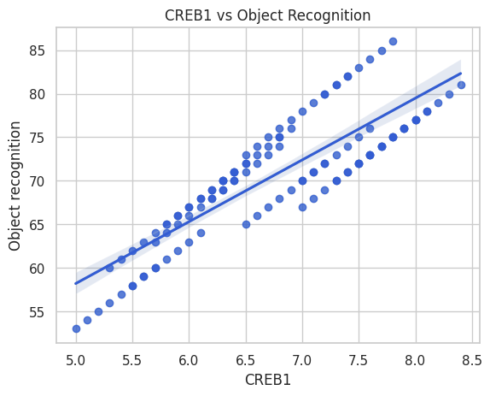
Neuro 105: Project Python
Does CREB1 expression correlate with object recognition performance?
A strong positive correlation was observed between CREB1 expression and object recognition performance. Higher CREB1 levels were associated with better cognitive performance
(r = .86, p < .001).
Figure 1. Relationship between CREB1 expression and object recognition performance.

